Slide 1
Differences of School systems in USA and Great Britain
Lukáš Strešík, Patrik Nádaský

Slide 2
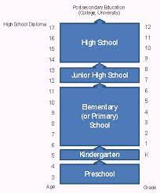
School grades in USA
it starts with preschool, then continous with kindesgarden, elementary school, junior highschool and ends up with highschool

Slide 3
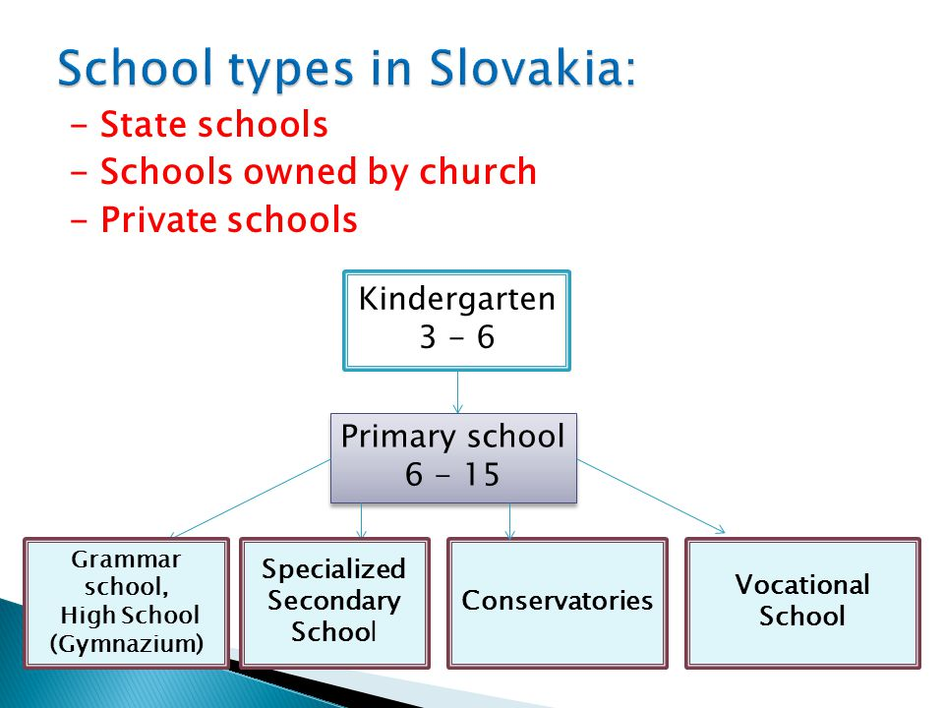
School grades in Great Britain
It start with kindergarden, then primary school then secondary school or gymnazium and then high school

Slide 4

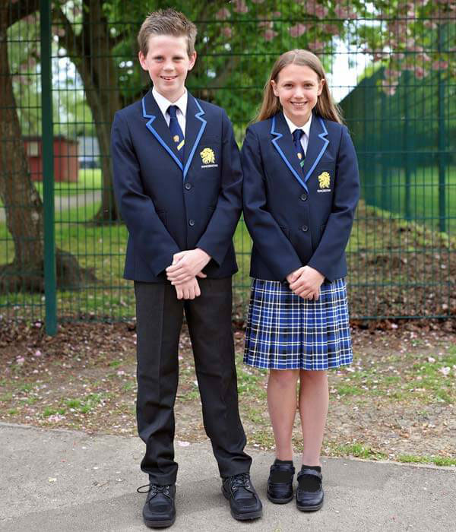
Uniforms in schools
USA
Great Britain

Slide 5
Sports
USA
Great Britain
Rugby
Football
Baseball
Basketball
Football
Rugby
Field hockey
Netball

Slide 6
National Anthem
USA
Great Britain
https://www.youtube.com/watch?v=FqxJ_iuBPCs
https://www.youtube.com/watch?v=I8KSAtos-dk

Slide 7



USA school grades
preschool
kindergarden
Elementary school
Age: 2 – 4 y.o.
Age: 5 y.o.
Age: 6 – 11 y.o.

