Slide 1
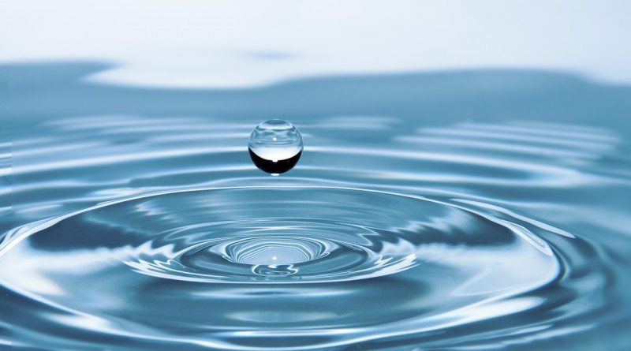
Community Action Project
By Global Scholars from Szkola Podstawowa nr 289 im. H. Sienkiewicza in Warsaw
May 2023

Slide 2
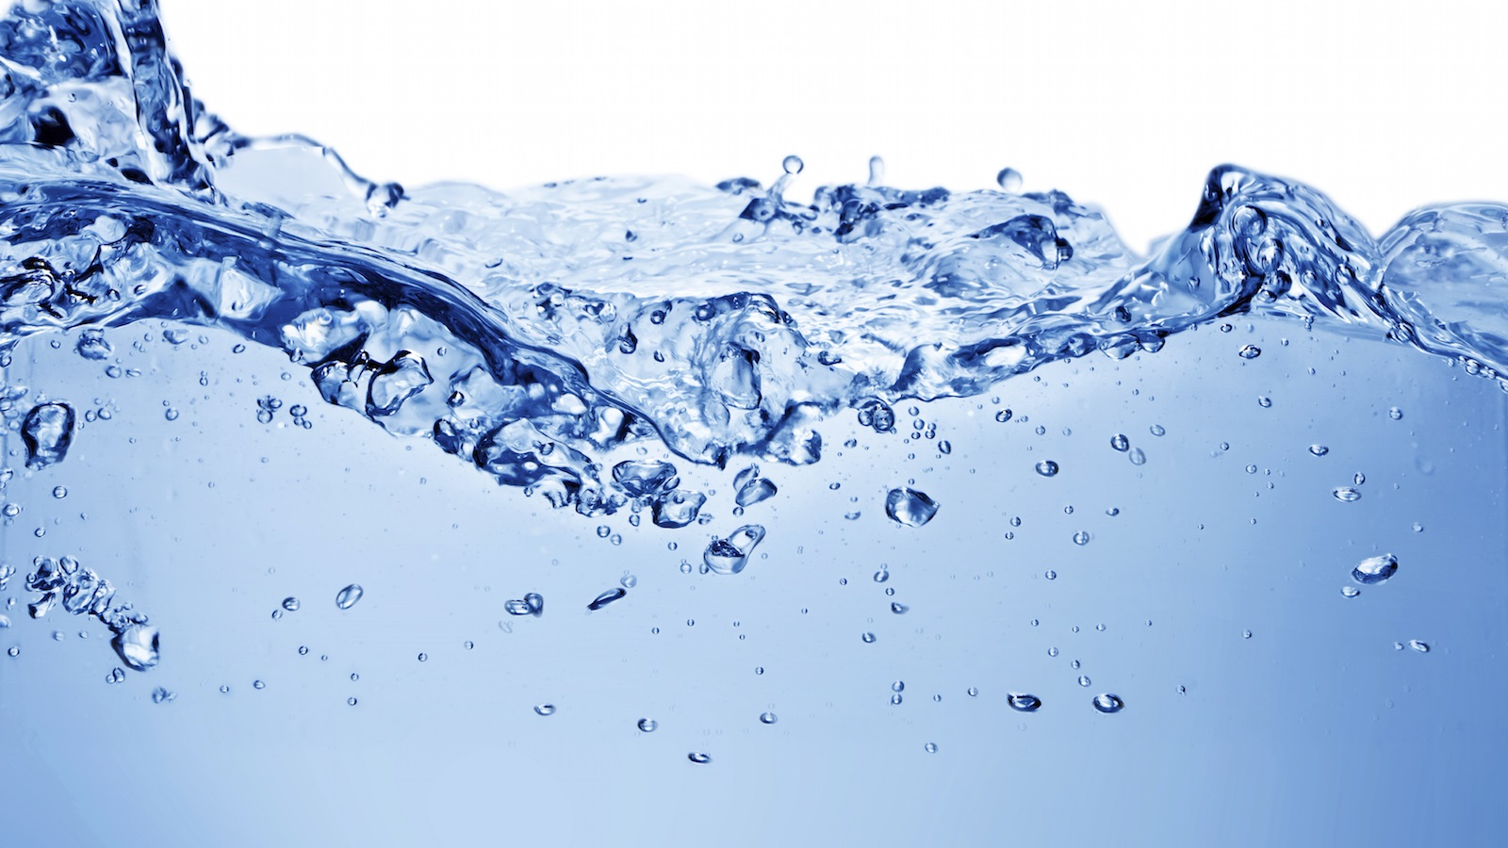
The goal of our community action project was to broaden our schoolmates’ knowledge about water. In particular, we wanted them to learn why water is important nowadays and how to save it in everyday life.

Slide 3
Step 1: Preparation
We selected some important videos and posters regarding our topic on the Internet. We created a quiz on Quizziz which incuded questions and answers about water from the posters and videos .

Slide 4
Step 2: Taking action and evaluation
Then we created QR codes. We hid the QR codes at school and invited some schoolmates to find them, watch videos and read information on posters. Finally, our schoolmates took part in the quiz to check how much they remembered about the importance of water and ways of saving it. According to the results of the evaluation quiz 84% of answers were correct.

Slide 5
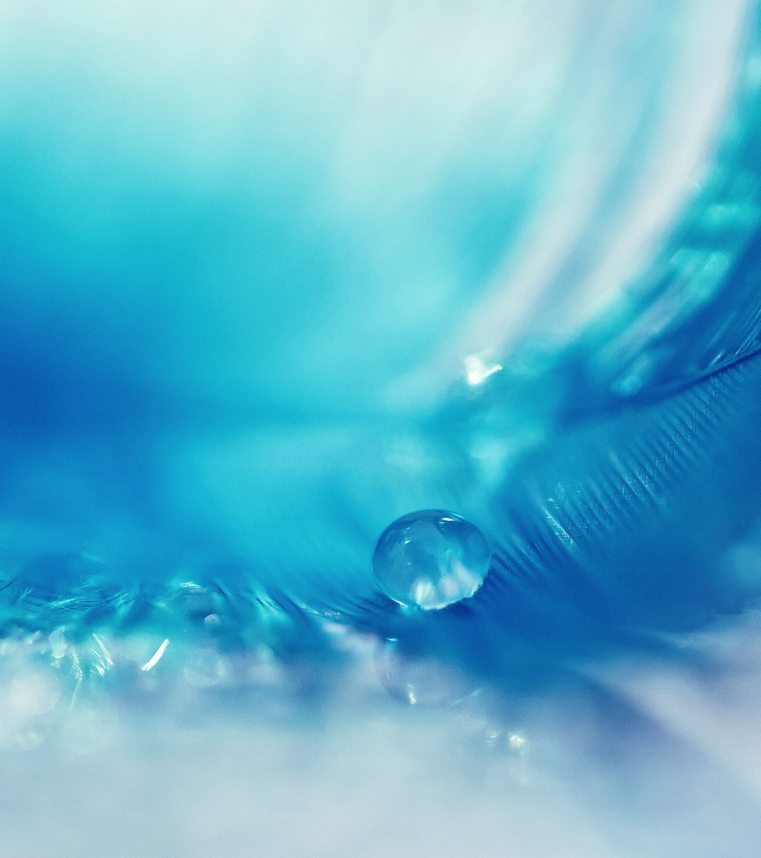
Step 3: Reflection
About 100 students took part in our action. We hope it will make them realize better why water is so precious on Earth.

Slide 6
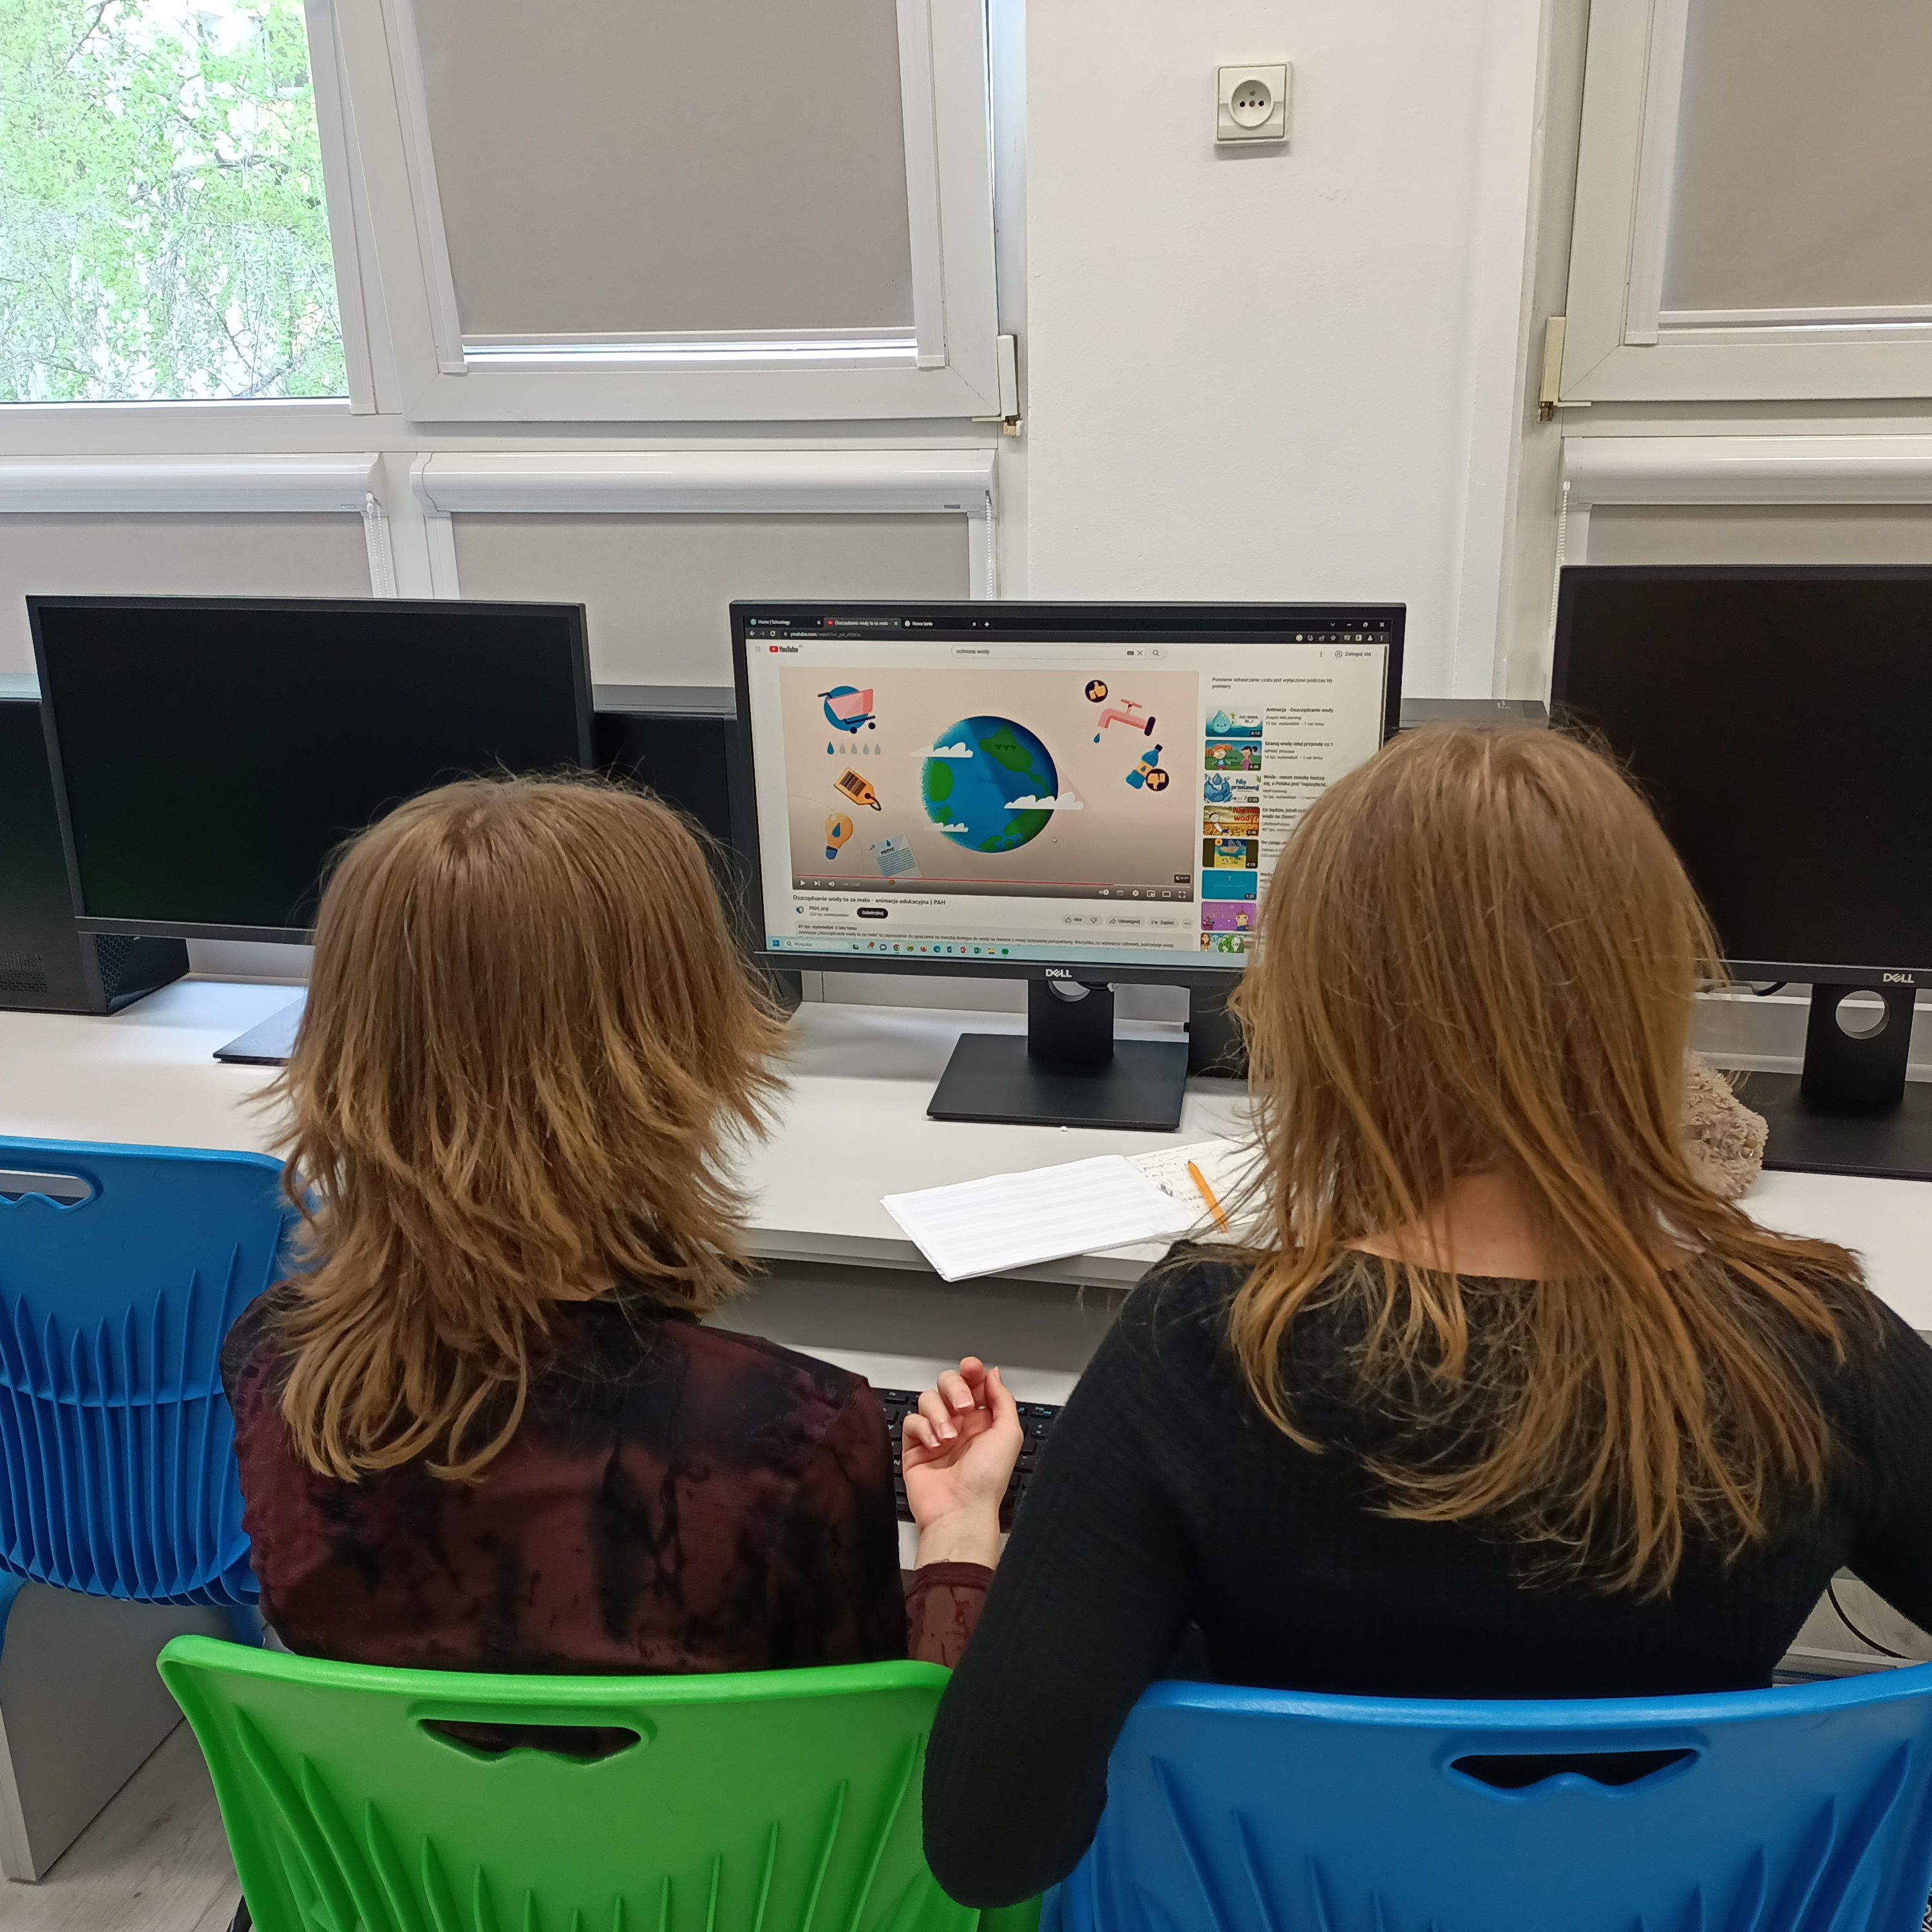
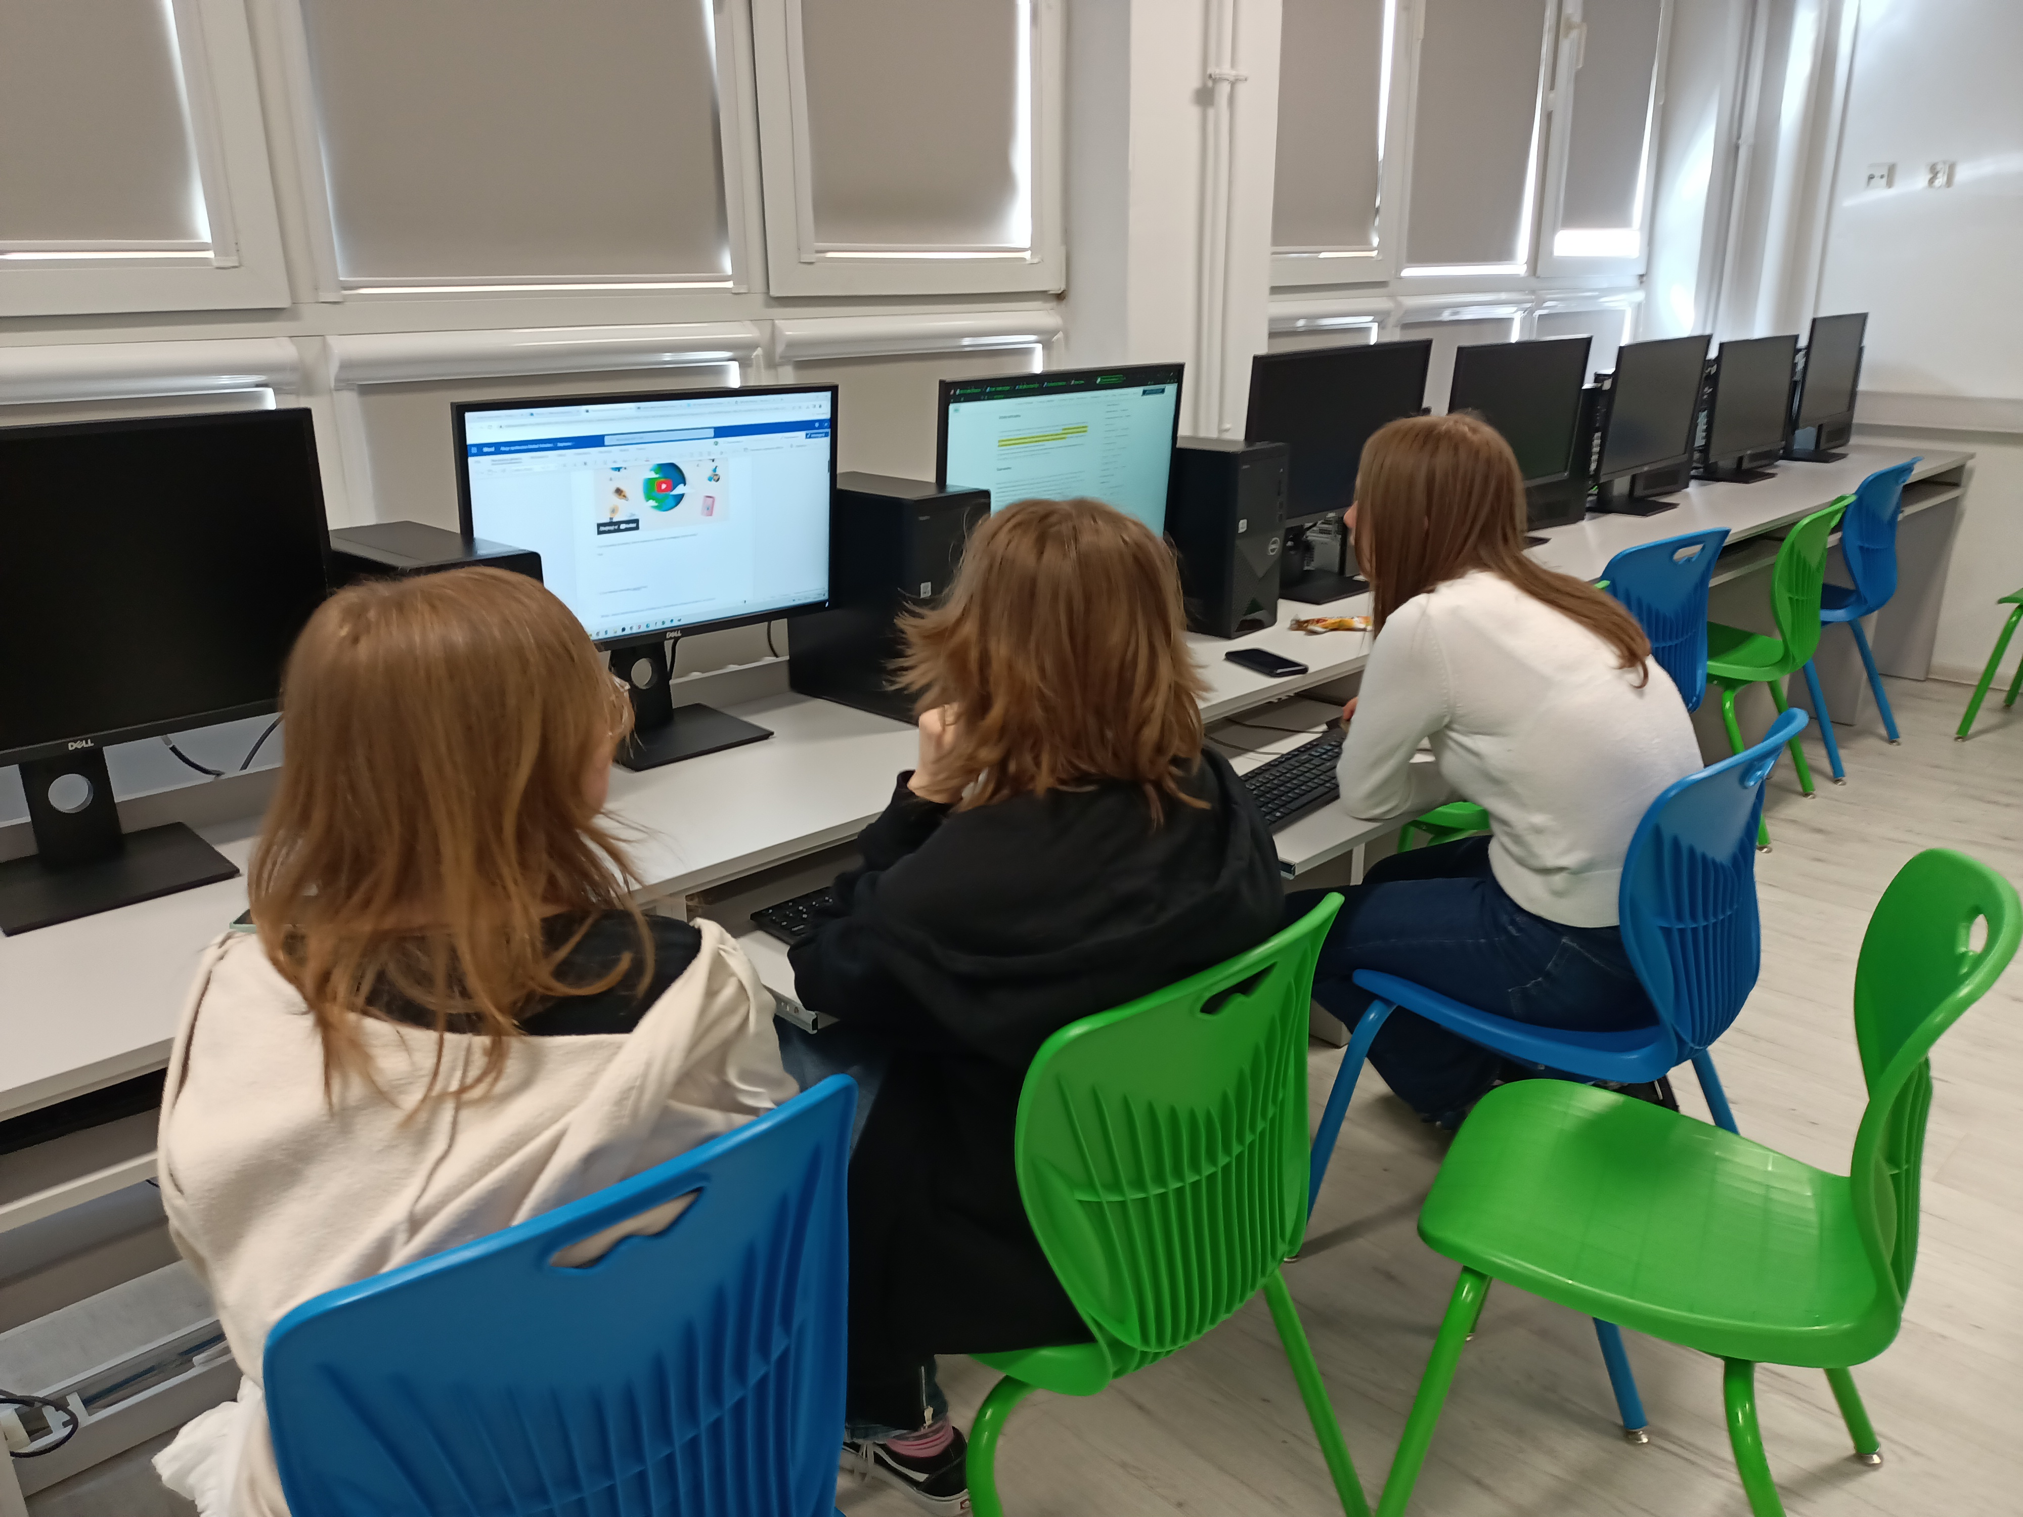
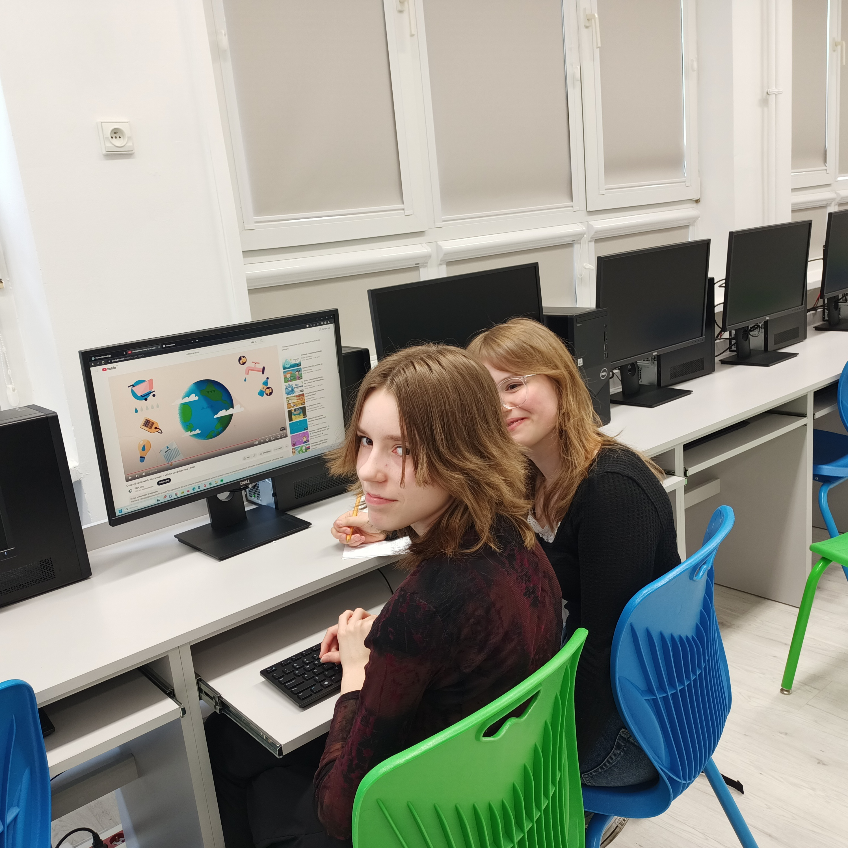
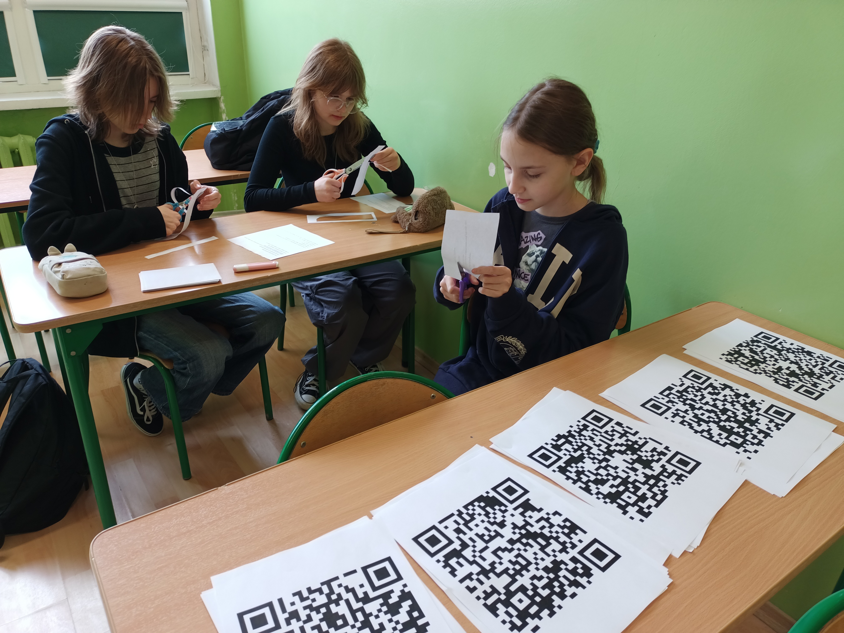
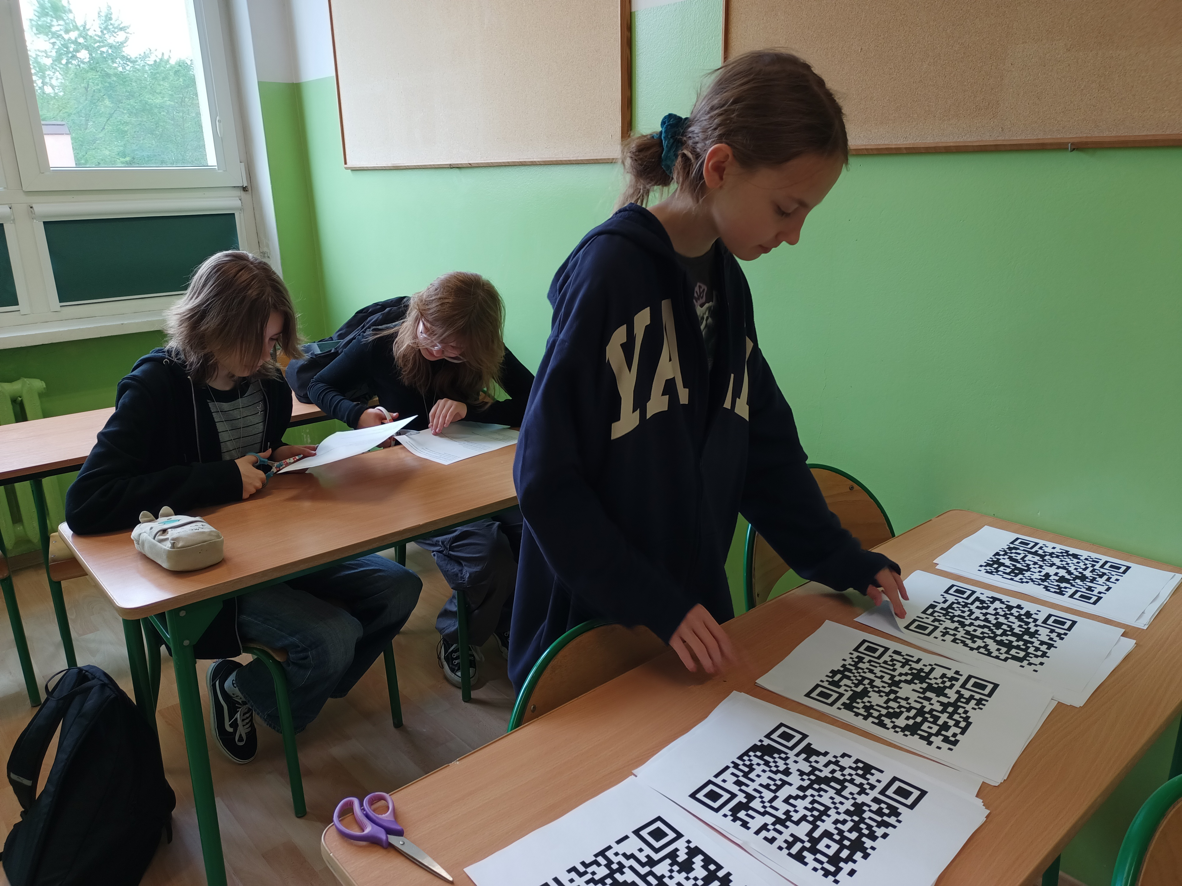

Slide 7
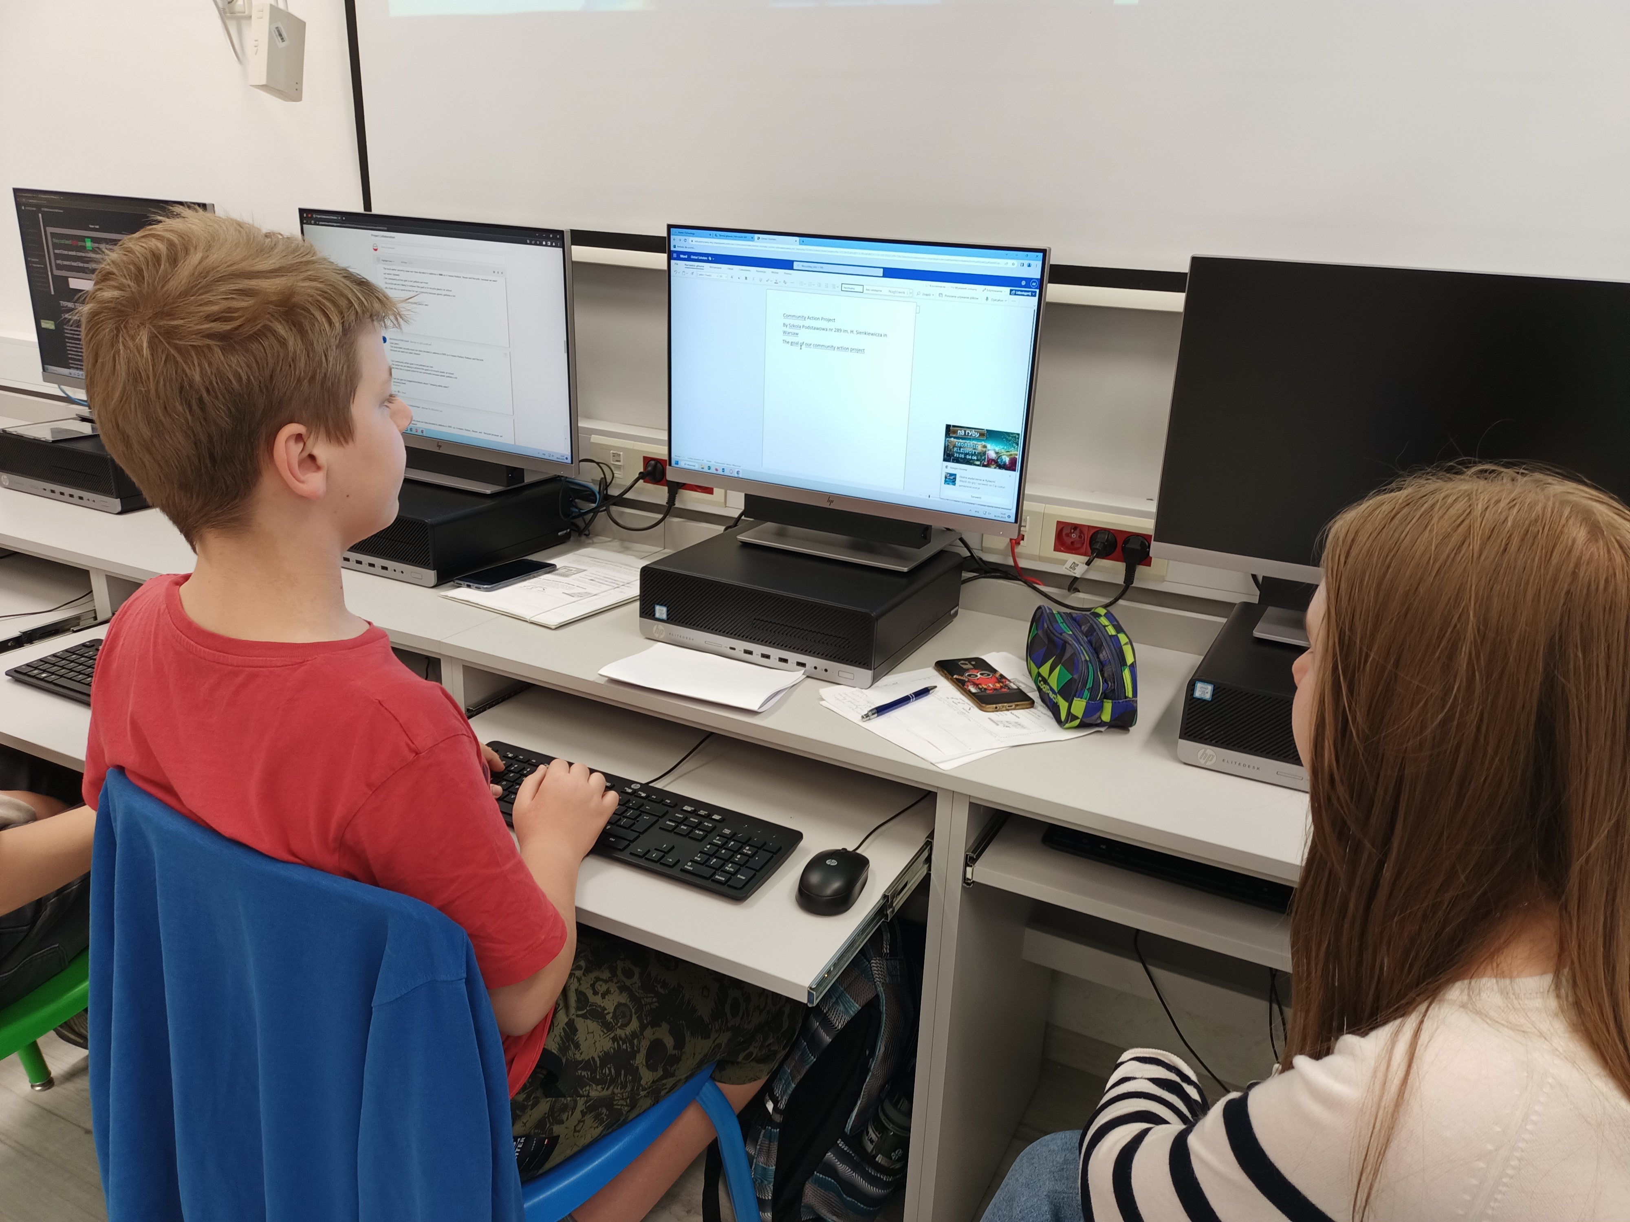
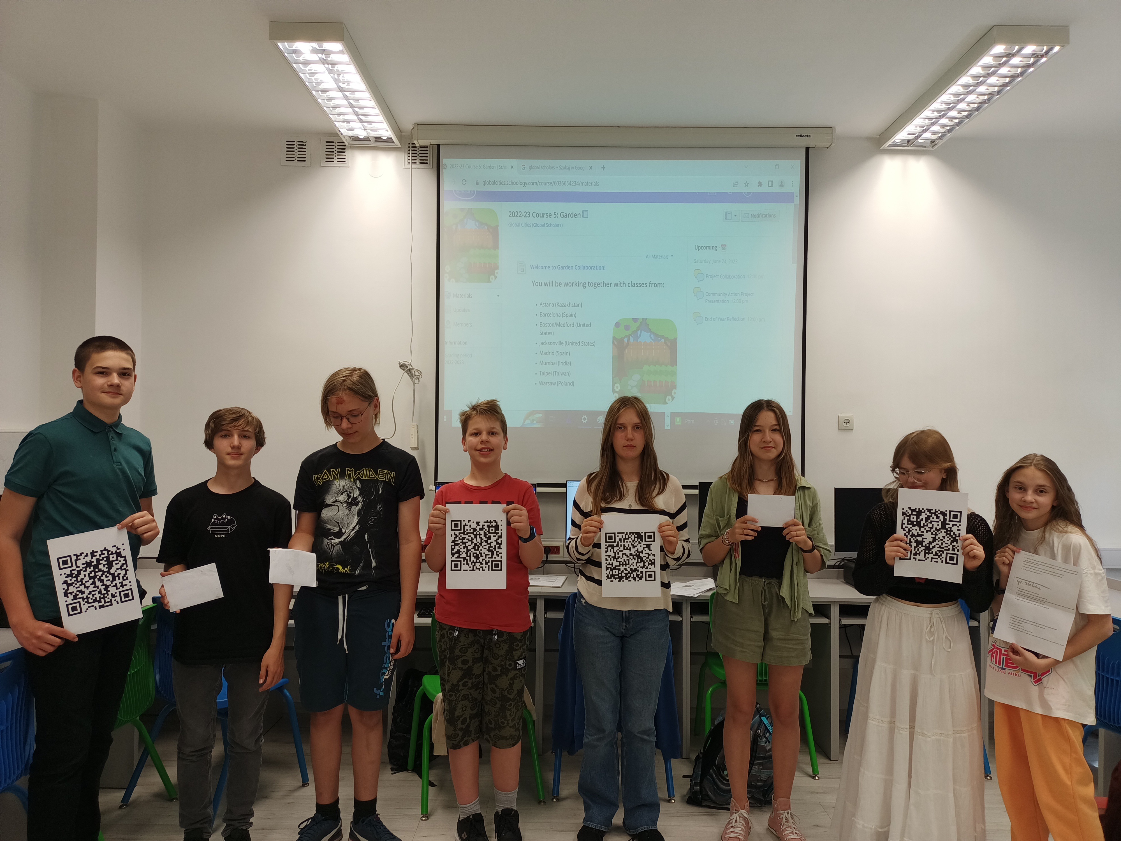

Slide 8
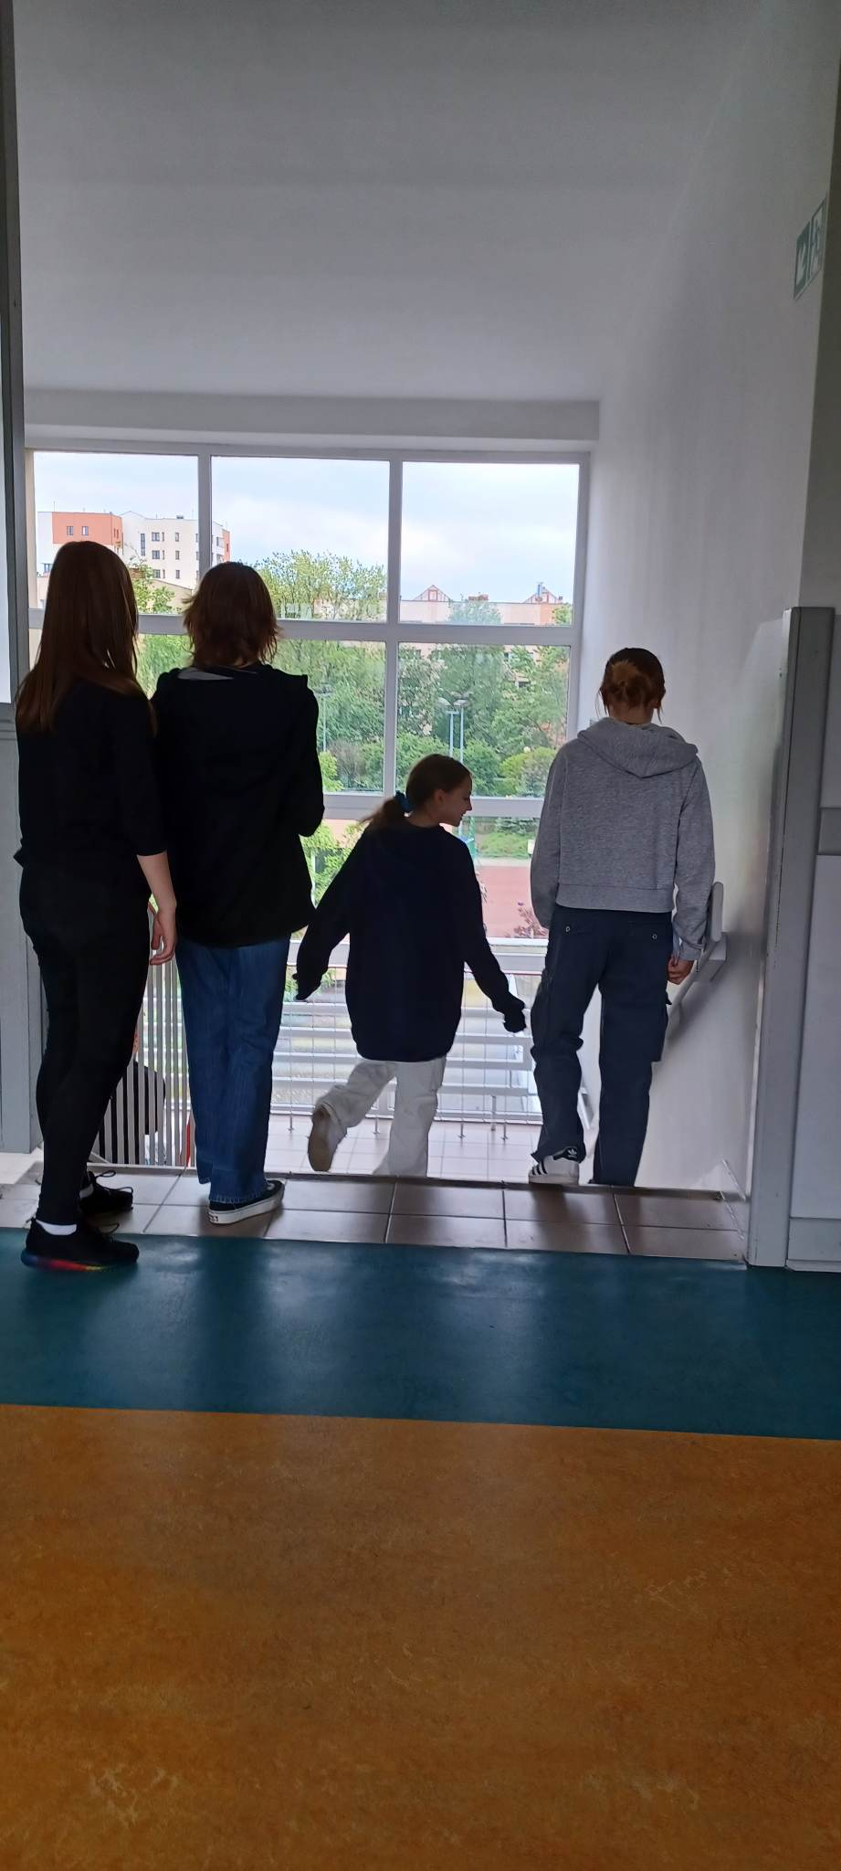
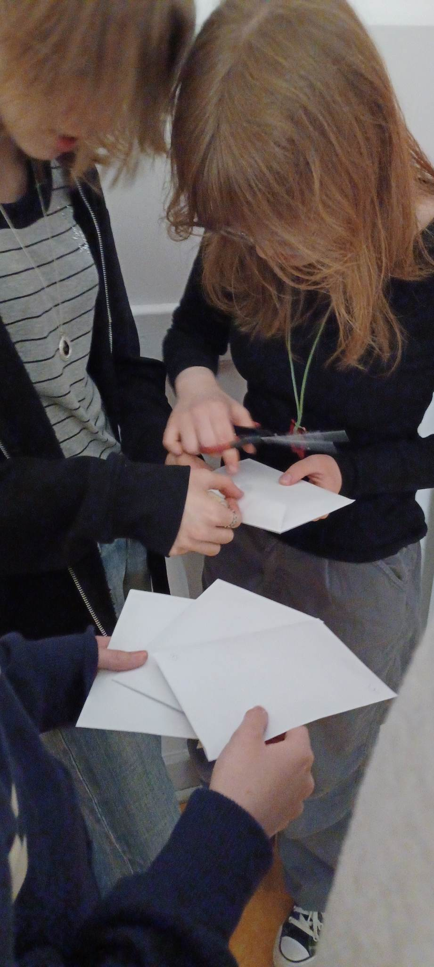
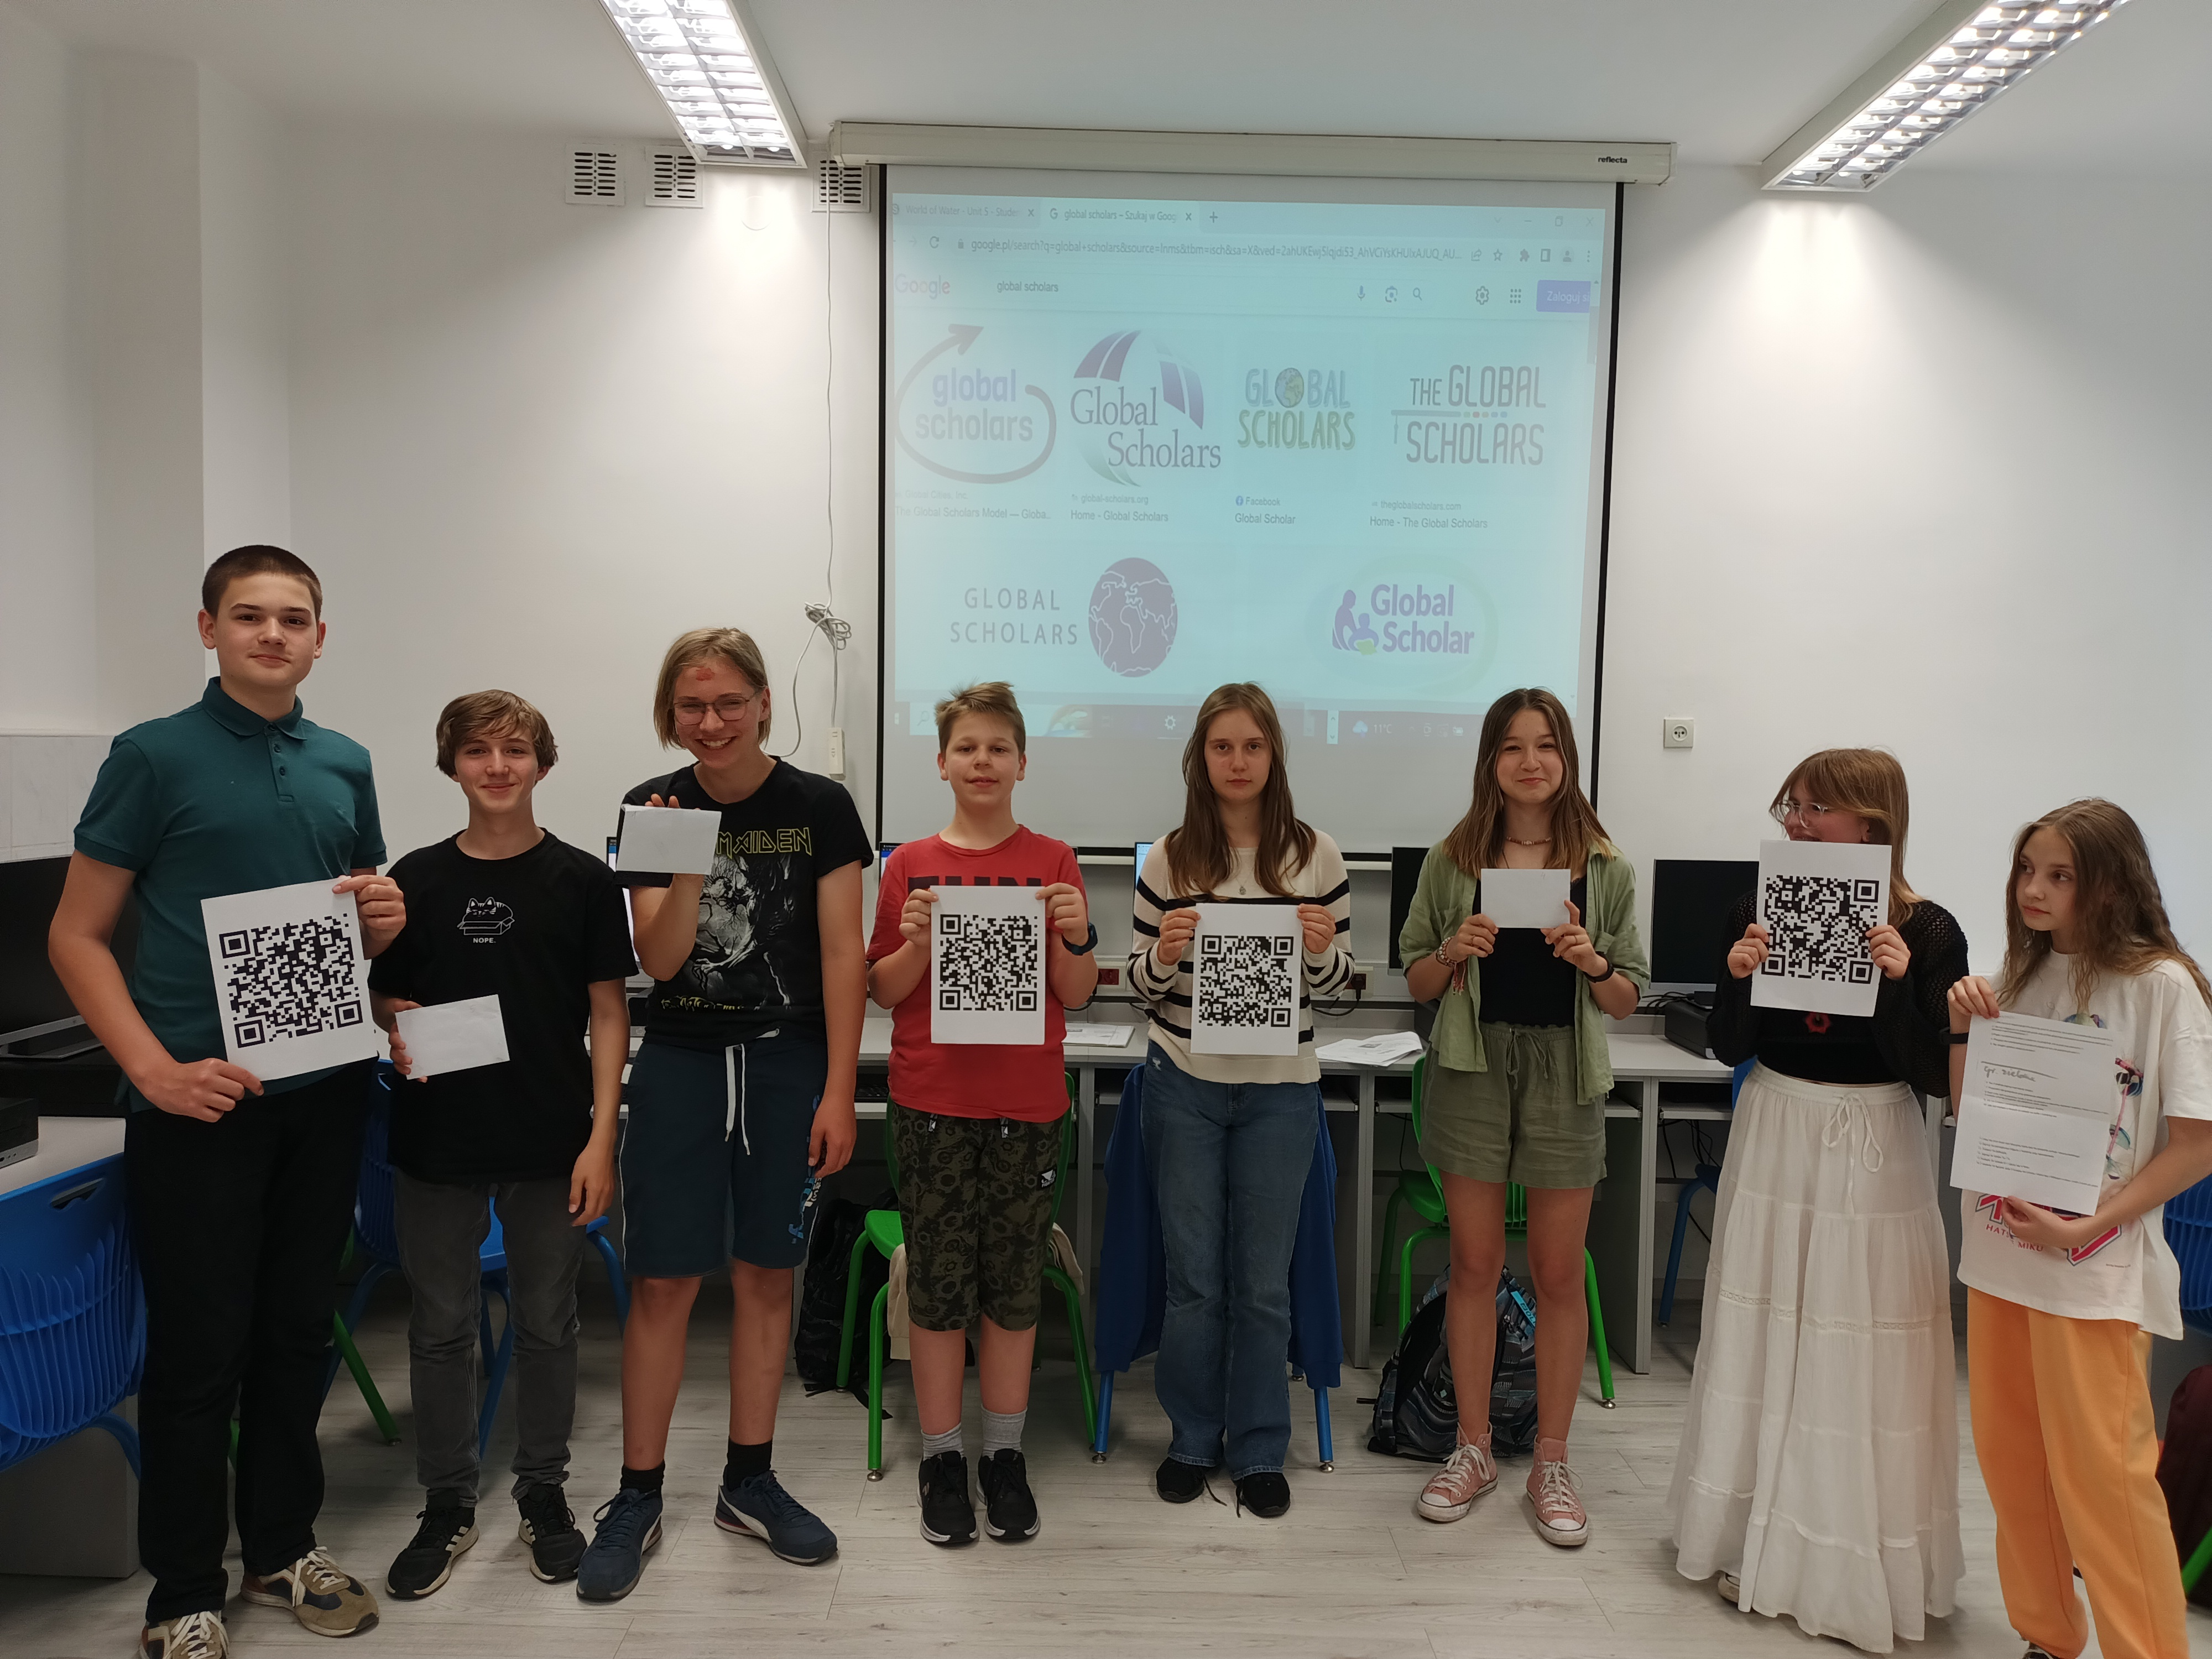
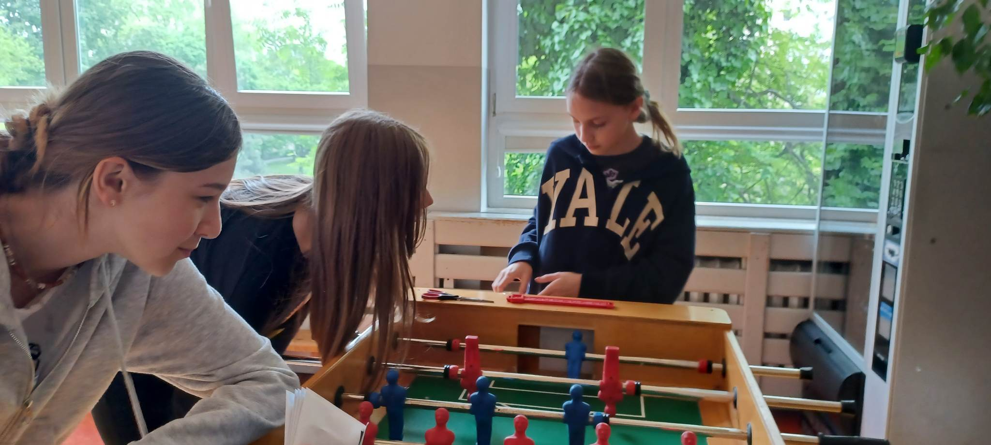
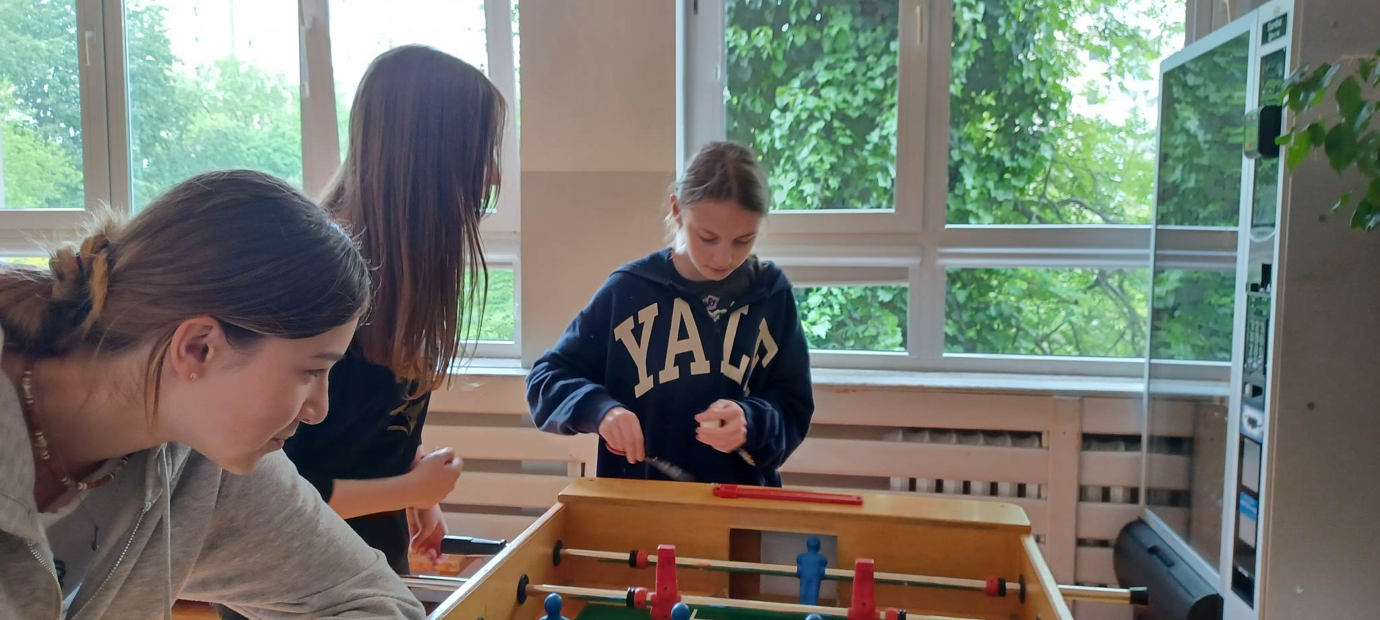

Slide 9
