Slide 1
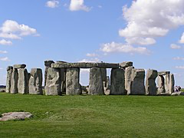
Stonehenge
Southern England

Slide 2
Stonehenge
Stonehenge is one of the most mysterious places not only in England, but also in the whole world. For centuries, it has stimulated the human imagination and prompted the creation of various theories. The stone circle, which consists of 30 outer rock blocks and 49 smaller ones, was erected in 3000 BC. on Salisbury Plain in modern Wiltshire.

Slide 3
Theories about Stonehenge
Why was Stonehenge even build? There are several hypotheses. The first assumes that the stone circle was to be used to observe the sun and the moon. The second indicates that Stonehenge held ceremonies related to the summer solstice and the shortest day of the year, of course in winter. Some researchers believe, however, that the stone circle was associated with funeral rituals. Of course, a lot of myths and uncreated stories have grown around Stonehenge, according to which the stone circle was supposed to be built by aliens or serve as a landing pad for visitors from another planet.

Slide 4
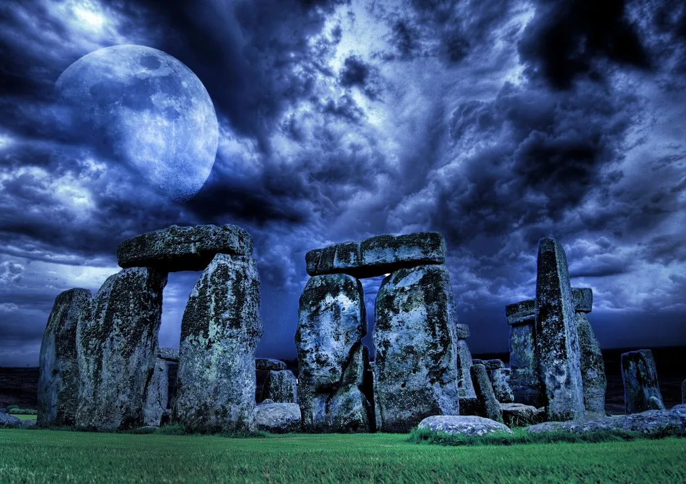
The oldest place in the world
It is probably the oldest place in the whole world, which was created to pay tribute to the Sun and the Earth. Pagan customs were practiced here as early as 2200 BC. and in the center of a circle with a diameter of 100 meters was a stone altar.

Slide 5
Observatory
Scientists believe that in addition to being a place of worship, Stonehenge once also served as an astronomical observatory. The whole was surrounded by an earth rampart and a moat, and a wooden gate led inside. The remains of burnt priests were supposed to land in over fifty pits at that time.

Slide 6
Legend
The most popular legend associated with Stonehenge says that the stone circle was built in the Middle Ages by a sorcerer named Merlin. He was supposed to use magic to transport giant stones from a temple in Ireland.

Slide 7
A stone used to observe the sky
Astronomers have proven that on December 2 of each year, the Sun is exactly between the two stone features of Stonehenge. This is one of the proofs that the creators of the building were interested in astronomy, and most likely used it to observe the sky.

Slide 8
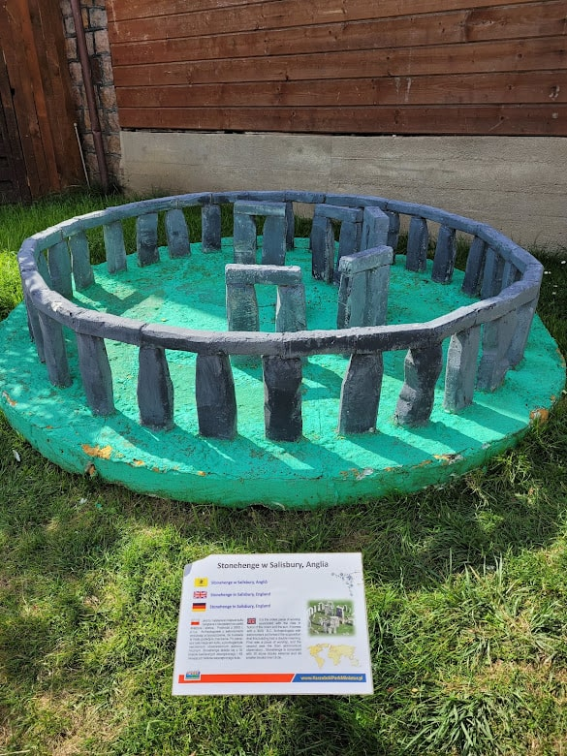
The magical properties of stones
The area around Stonehenge is very strongly magnetized. So much so that there is almost no vegetation nearby. This is the reason for numerous speculations and rumors that the stones have magical properties.

Slide 9
Thank you for your attention
Emilka Szpilarska

